Slide 1
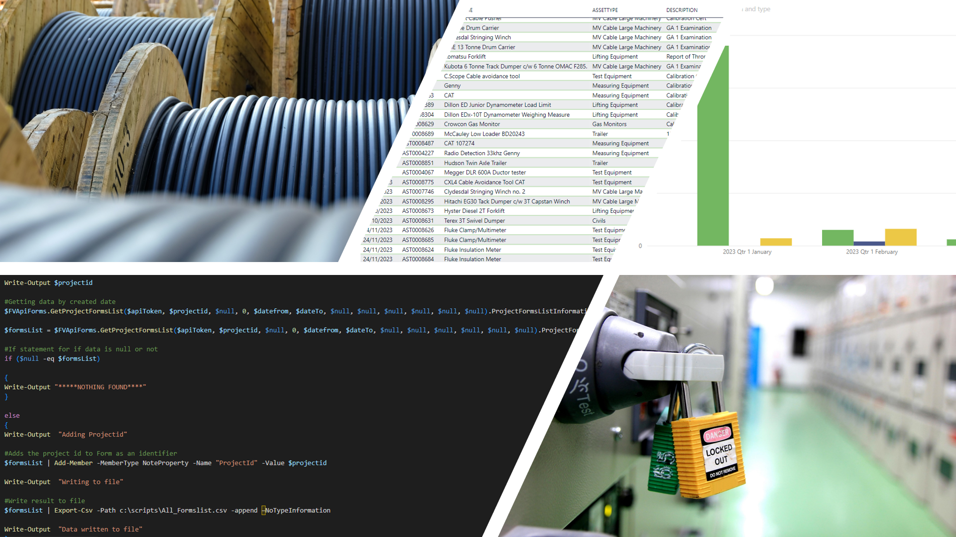
KPI WITH POWERBI
Streamlining report building with PowerBI and PowerShell

Slide 2
AGENDA
Introduction
Problems & Primary Objective
Old Process
Use Case – Time Saving
Technologies Used
New Process
Live Demo
Incorporated Systems – Rolled out
Key Milestones
Problems Encountered & Solutions
Future Development
Development since project completion
Acquired knowledge and skills

Slide 3

Introduction
Utilities sector since 2006
Various roles (Business Systems)
Expanded into general IT - road to SETU
Inspiration for the project
Work Related
Adding value
KPI analytics

Slide 4
Problem & PRIMARY Objective
Data for KPI reports within the company were pulled manually from locally hosted and remotely hosted cloud-based systems. The data was then processed manually by staff into report visuals
This project’s objective was to streamline and automate this process. By pulling data via system APIs and then making it available to PowerBI, by storing it into the organisation’s SharePoint Online as CSV Data

Slide 5
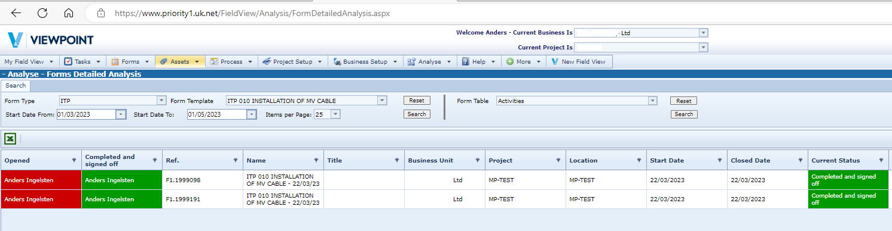
OLD PROCESS
Access systems
Go to report view
Pull report to excel
Review data - if missing data - contact users
Create report visual
Circulate

Slide 6
USE CASE – Time SAVING
A user spends 1.5 hour every week to access Fieldview and compile a report of the amount of vehicle reports submitted by staff that week. 1.5 hours x 48 working weeks = 72 Hours which equates to 9 working days per year.
Annual Salary €45k = 173.08 per day * 9 working days = €1557.72

Slide 7
NEW PROCESS

Slide 8




TECHNOLOGIES USED
PowerBI
PowerShell
DAX
SharePoint

Slide 9
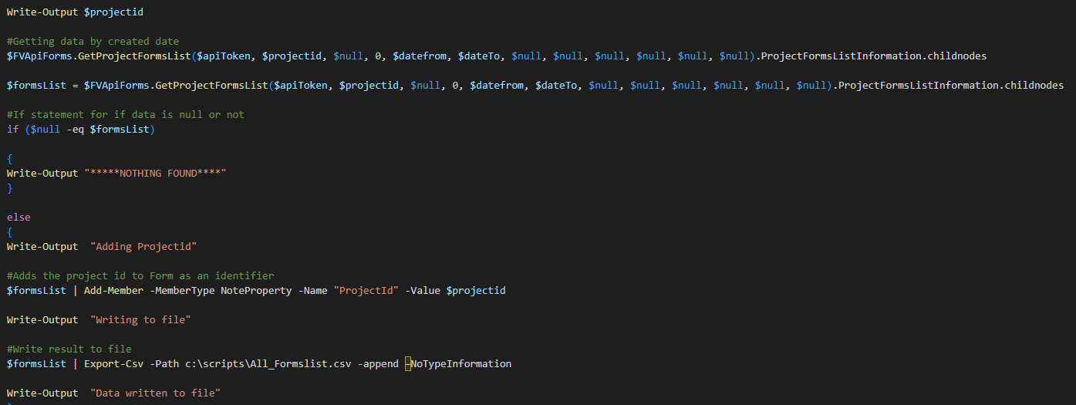
LIVE DEMO

Slide 10
“Best thing you can do now, is to shut up and not to tell anyone else about this and remember look after our team first.”​
CFO & Company Supervisor

Slide 11
INCORPORATED SYSTEMS – ROLLED OUT
Static data & reference tables
Smartsheet
Timesheet table
Visualization of hours per contract and users
Fieldview
Field Staff Hours
Count of Vehicle forms
Count of Forms
Pipedrive
Deals & Activities
Visualization of pipeline with weighted probability
Service Scheduled
Visualization of upcoming service dates
O365
Asset Manager

Slide 12
Key Milestones
1
Research, training & requirements
2
Functional Fieldview & Pipedrive API in PowerShell
3
First PowerBI dashboard with DAX scripting
4
Automation of data refresh, Scripts and PowerBI

Slide 13
Problems encountered & solutions
Design
Power Automate
Data Connector
Deciding upon which methodology to use, directly to PowerBI, Python etc.
Research resulted the ​PowerShell with Sharepoint Online ​path.
Power Automate Desktop flow to failing depending on user logged onto machine or not.
Utilizing Task Scheduler as a solution instead.
Discovering that Data connectors must be inside the corporate network.
Move connectors to devices that are more reliable than a laptop, hosted domain server.

Slide 14
Future Development
Review of the current state​. Iterations and tweaking of scripts, review of the refresh schedule
Adding more data sources. Existing and new data from for example Fieldview as per company requests.
Long Term future functionality. In relation to Data persistence other solutions will be reviewed, for example SharePoint Lists, MS Dataverse and Azure SQL Database can possibly be in scope.

Slide 15
Development SINCE PROJECT COMPLETION
Published to more departments
Training of staff in PowerBI drill down
Automated PDF file export from Fieldview to SharePoint and PowerBI
Changes to Schedule

Slide 16
AQUIRED knowledge and skills
Setup, generate and publish PowerBI visuals.
Pull in data sets and model their relationships.
Using data-connectors for PowerBI.
Using PowerShell to pull data over API’s.
Using DAX language for bespoke queries.
Automation of PowerShell scripts and PowerBI data sets.
Project Manage an IT project from start to finish.

Slide 17
ANY QUESTIONS?
Anders Ingelsten
20095402@mail.wit.ie
http://ingelsten.surge.sh/

